Slide 1
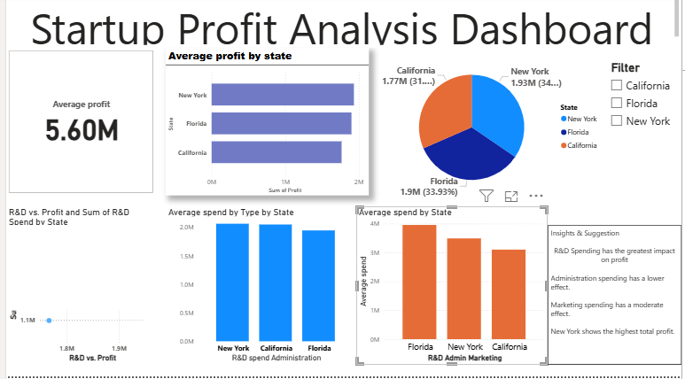
Profit Analysis Dashboard
Project Name:- Data-Driven Insights for Startups
Prepared by:- Pooja Tamboli

Slide 2
Overview
Objective: Analyze how R&D, Marketing, and Administration spend affects Profit
Data Source: Startup financial dataset
Tools Used: Power BI

Slide 3
Key Insights
Total Profit across all startups: [Insert Value]
Highest Profit by State: [Insert State]
Major expense contributor: [R&D / Marketing / Administration]

Slide 4
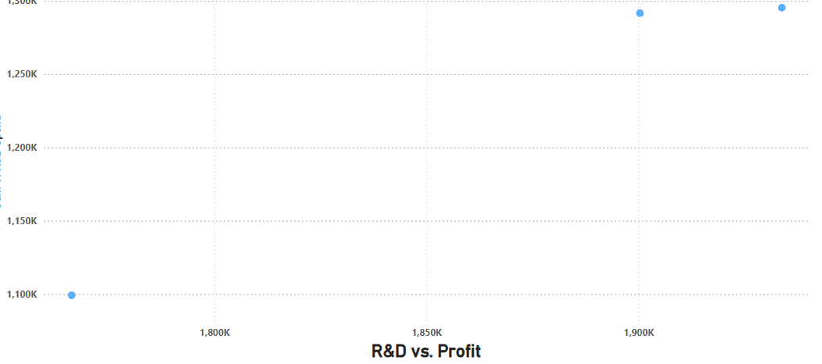
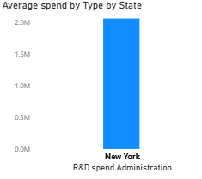
R&D vs Profit
Positive correlation observed between R&D administration Spend and Profit
Line chart demonstrates increasing profit with higher R&D investment

Slide 5
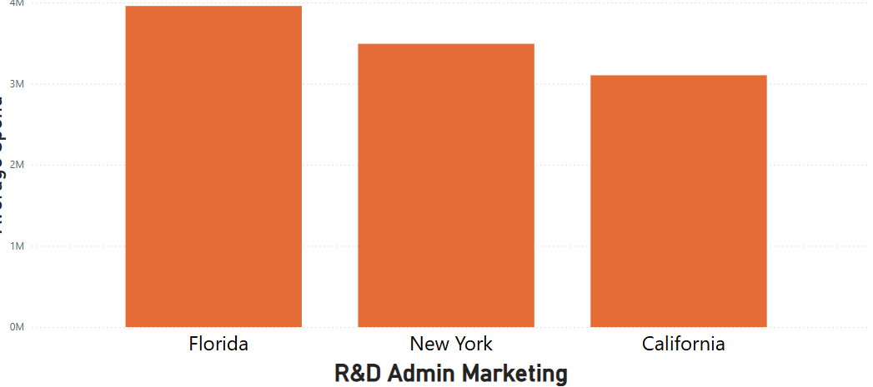
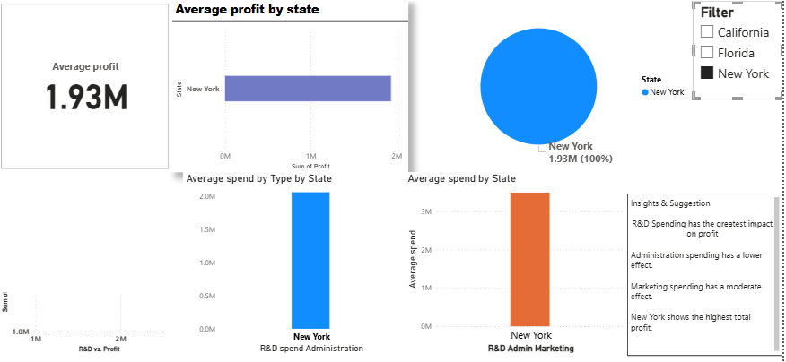
Marketing Spend vs Profit
Marketing spend shows moderate effect on Profit
All profit

Slide 6
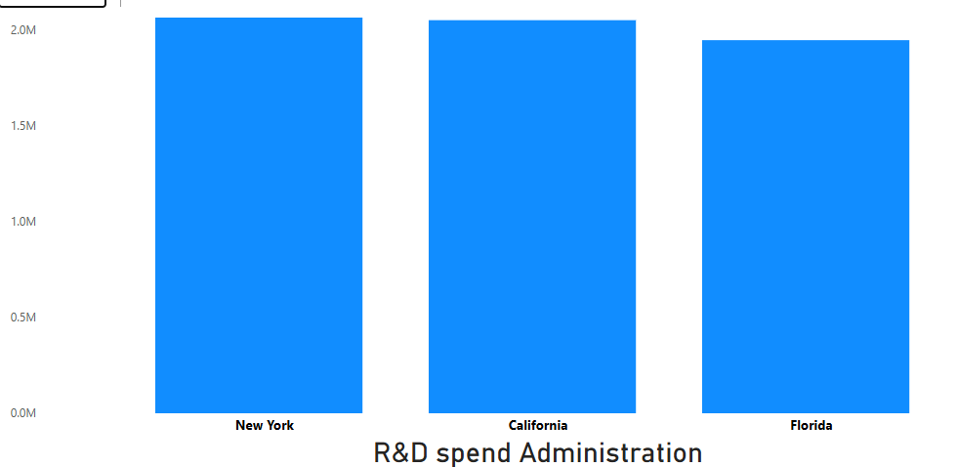
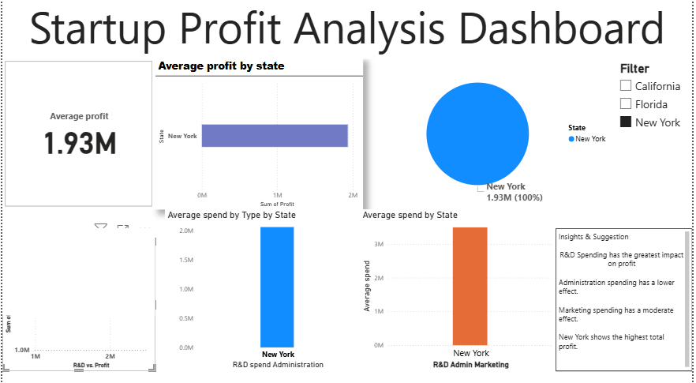
Administration vs Profit
Administration cost has minimal impact on Profit
Maximum profit

Slide 7
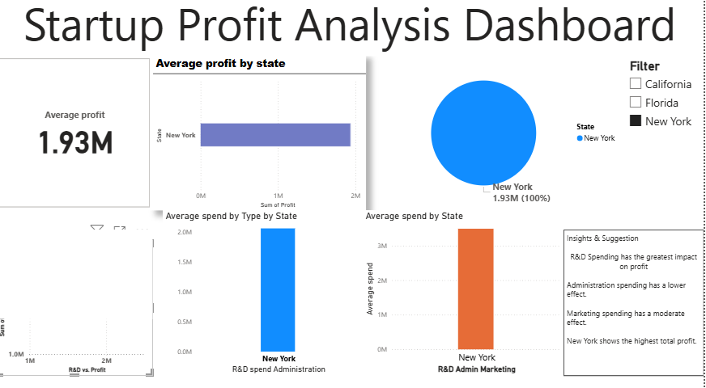
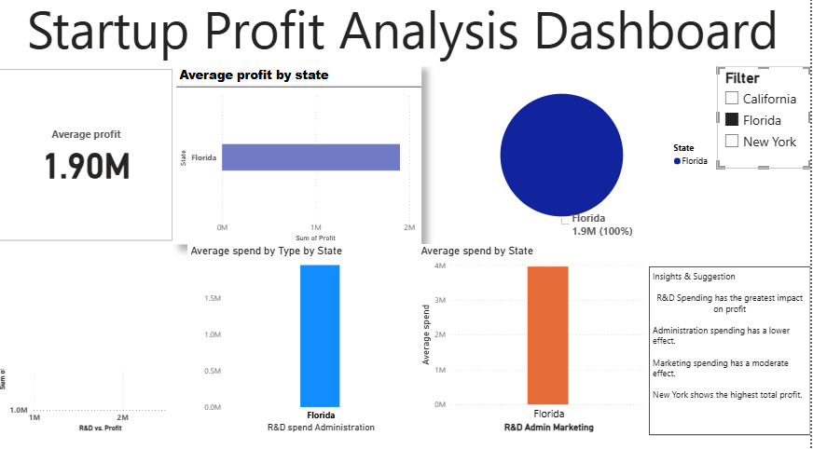
Profit by State
Highest Profit
Lowest Profit

Slide 8
Recommendations
Increase R&D investment for higher profitability
Optimize Marketing expenses for maximum ROI
Minimize unnecessary Administration costs
Focus expansion on high-profit states

Slide 9
Summary
Data-driven insights help strategic decision making
Dashboard provides real-time monitoring of Profit drivers
Next Steps: Implement suggested strategies and track results

Slide 10
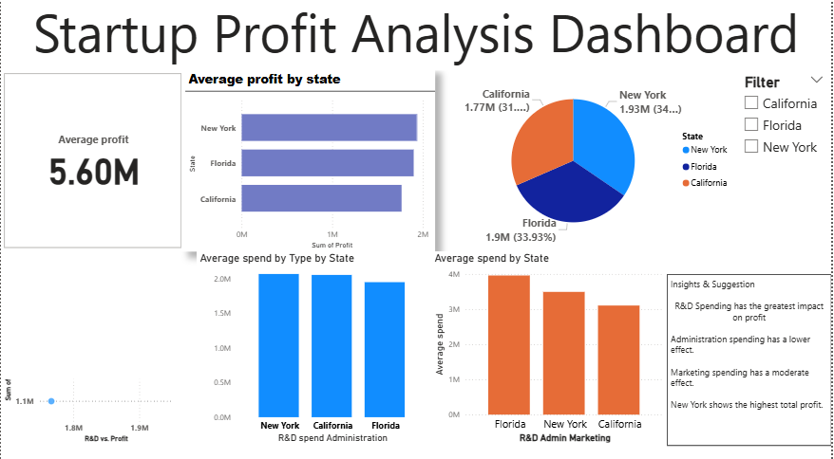
Thank you
Pooja Tamboli

